Slide 1

Processing, microstructure characterization and mechanical testing of SS441
Technical group project 2019 – AM Database
September 27, 2019

Slide 2
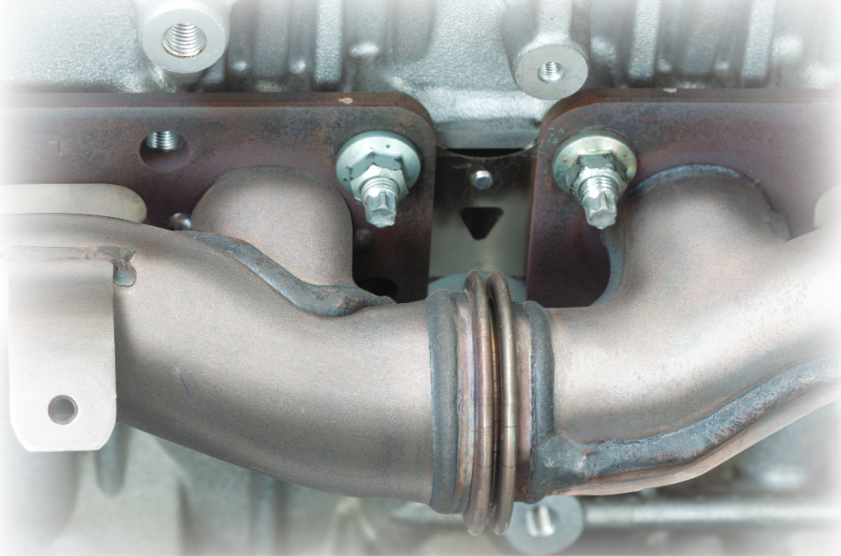
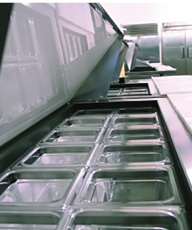
SS441
Composition (wt.%):
Fe-18.9Cr-0.034C-0.79Nb-0.28Ti-0.1N
Conventionally produced:
Good oxidation, corrosion and creep resistance
Used in, e.g., heat exchangers

Slide 3
Background
Powder provided by Kanthal (gas atomized by Sandvik Osprey)
Part of project at UU
Printed parts, studied varying VEDs
Part of a Hero-m 2i project at KTH
Microstructure characterization + modeling
Partly part of the DEMA project at KTH/Chalmers
Printed parts to identify process window

Slide 4
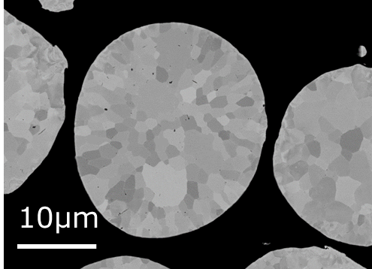
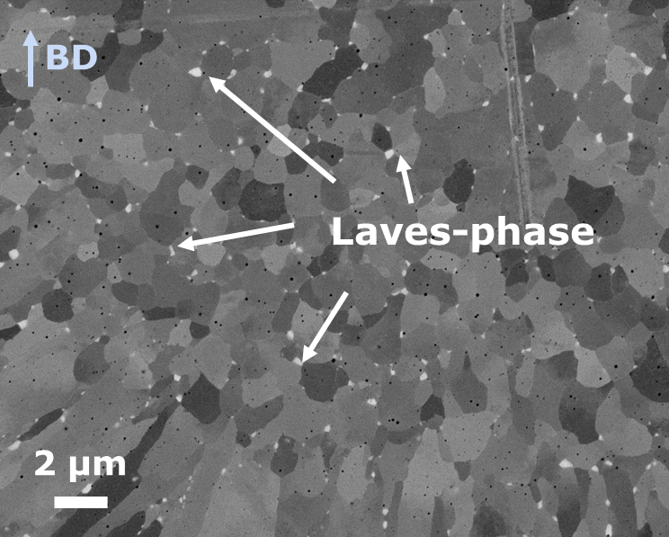
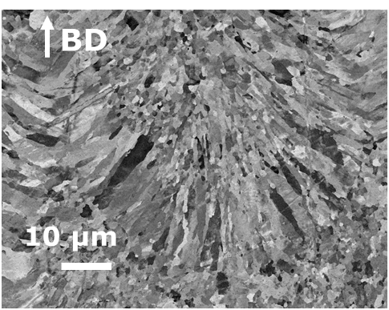
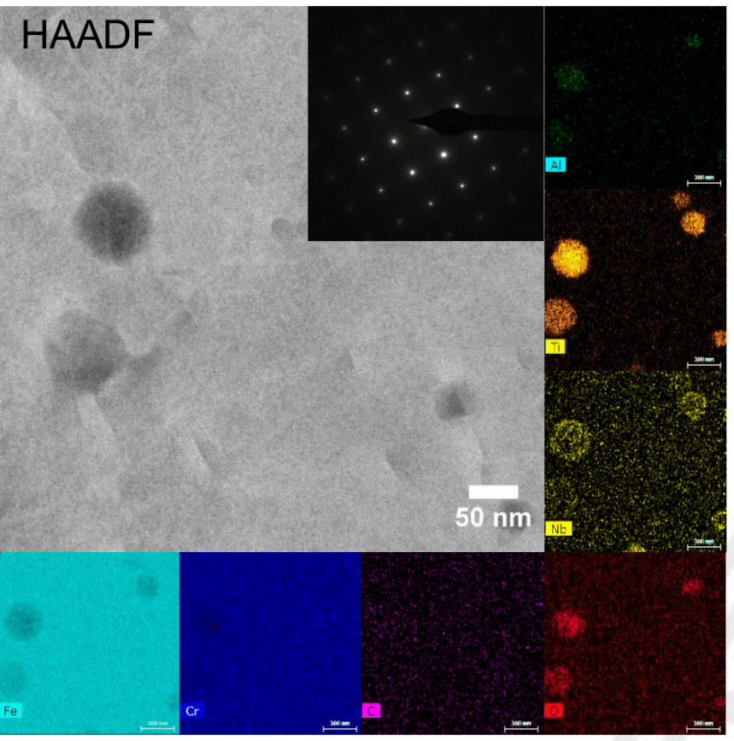
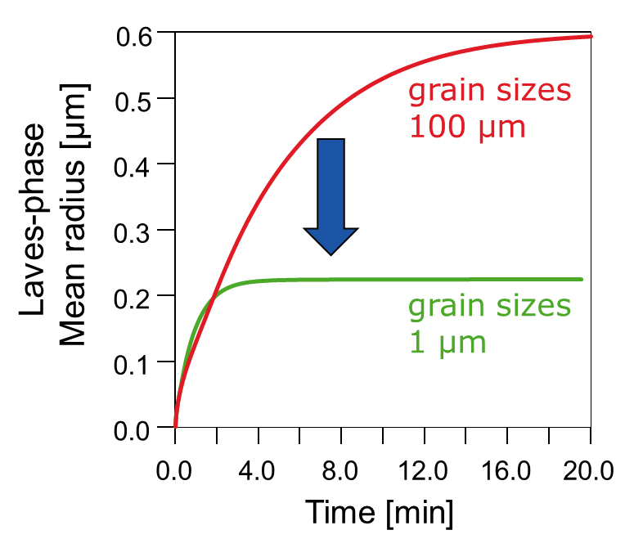
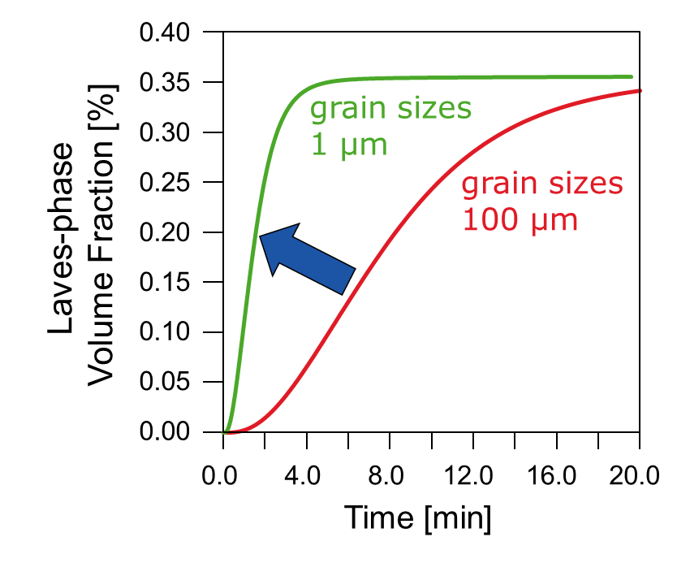
Produced results
Microstructure characterization of powder, as-built and post-heat treated samples heat treated parts: LOM, SEM, TEM, EBSD, EDS
Mechanical testing of post-heat treated parts: Impact toughness tests (Charpy V) and tensile tests at room temperature
Calculations: Micro-segregation profiles and solidification paths, precipitation kinetics
→ Data (results) to be curated

Slide 5
Associated data/metadata
Feedstock
Production method, composition, powder properties, handeling etc.
Printing details
Machine brand/version, printing parameters (VED, scanning strategy, build plate T), powder batch etc.
Post-heat treatment
Furnace, furnace atmosphere, heating and cooling rate etc.
Testing/characterization
Sample preparation, sample dimentions etc.
...?

Slide 6
Your data?
What kind of results is your research producing? What should be captured/curated/stored?
What is the associated data/metadata to be stored with your results to make it useful in the future?
How should your data be structured?
...

